Slide 1
STUDENT REPOSITORY SYSTEM
POLA SAIKALYAN
177511

Slide 2
CONTENT
Introduction
Existing System
Disadvantages
Proposed System
Advantages
Software Requirements
UML Diagrams
Conclusion

Slide 3
INTRODUCTION
The main objective of this Repository system application is to store all the details of the students permanently by using the one-time registration process.
The students can register their details at once and they get one unique id which is useful to fetch their details to any job application automatically.

Slide 4
EXISTING SYSTEM
In the existing repository system, the students have to enter their details every time whenever they required for filling the job application.
Student don’t have any Unique ID in Existing system.

Slide 5
DISADVANTAGES
In Existing System, Student has to fill all personal details everytime he want to apply for a Job Application.
It is a Timeconsuming process.

Slide 6
PROPOSED SYSTEM
In the proposed repository system the students no need to enter their details every time.
By using their unique registration Username the details are automatically fetched to the application only extra details required are to be entered.
The students can update their details in the existed profile whenever they required.
It is the user-friendly environment and less time-consuming.

Slide 7
ADVANTAGES
The Details of Student will auto-populate in fields which are required while applying any job through Student Unique Id.
There will be no misplacement of Student Details

Slide 8
SOFTWARE REQUIREMENTS
Operating System : Windows
Database : SQL Server 2014
IDE :Visual Studio 2019
Platform : .Net
Web server : IIS
Front End : Javascript, CSS, Html

Slide 9
FLOWCHART
Start
Admin
Student
Login
Login
Register
Edit Details
ApplyJobs
Applied Jobs
No
Input correct
Fill the Information
Input correct
Yes
Yes
No
Add New Job
Manage Students
End
Logout
Maintain all the data in database

Slide 10
USECASE DIAGRAM
Register
Login
Login
Add Jobs
Edit Details
Manage Students
Apply Details
Admin
ApploiedStudents
Student
Applied jobs
Logout
Logout

Slide 11
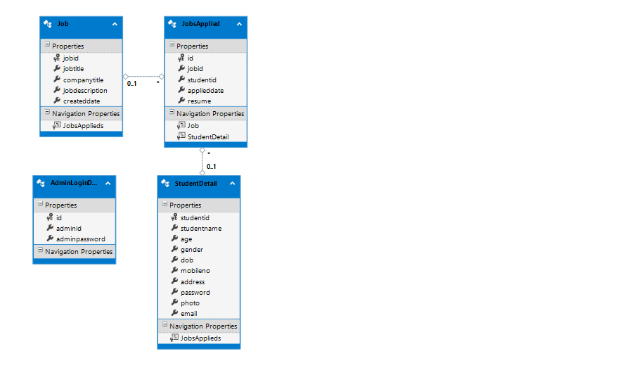
CLASS DIAGRAM

Slide 12
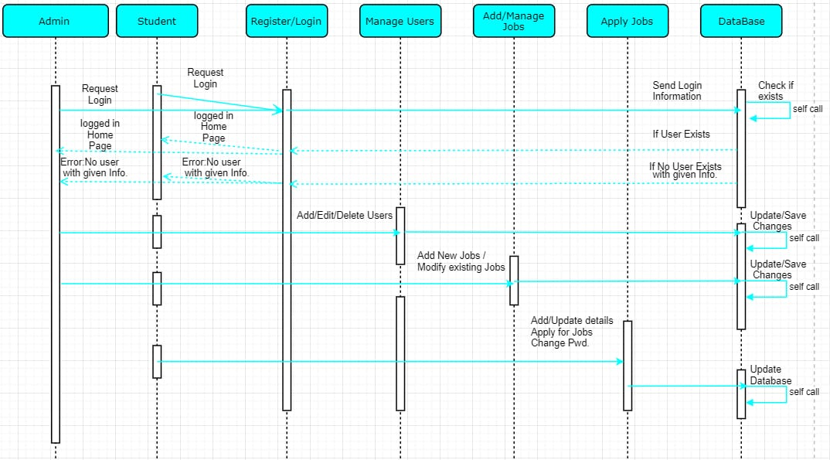
SEQUENCE DIAGRAM

Slide 13
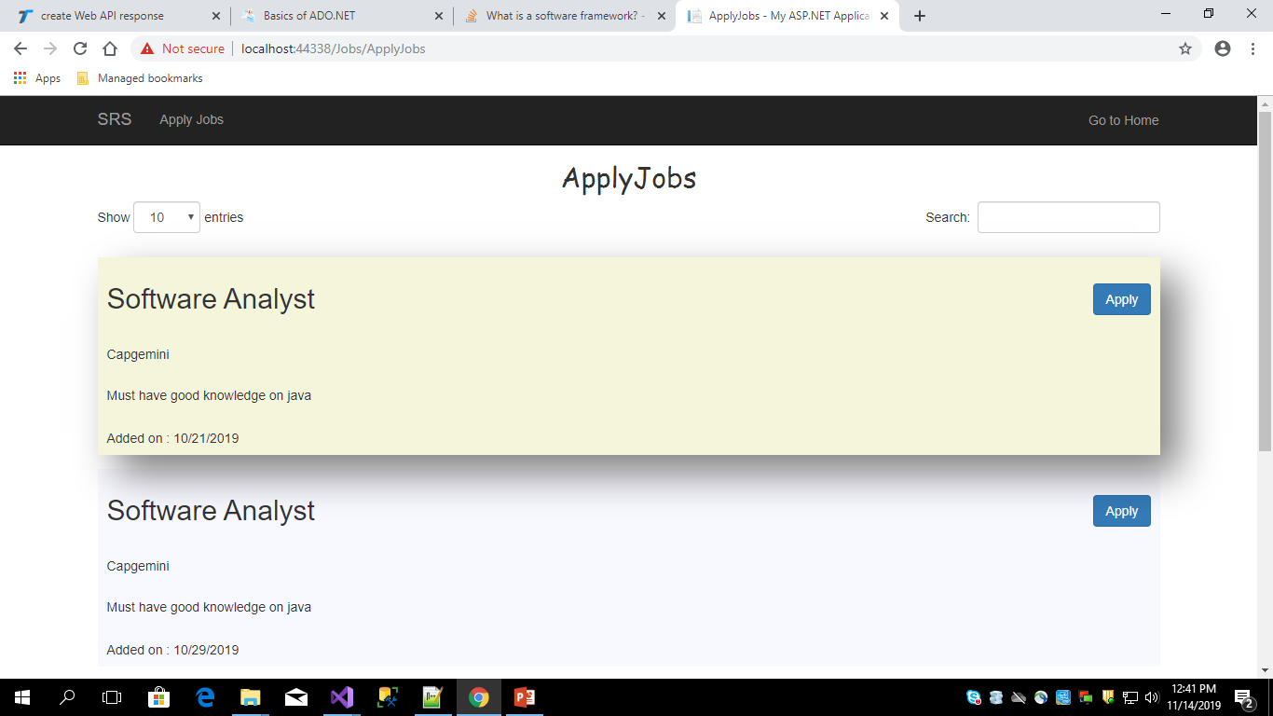

Slide 14
CONCLUSION
The project aim to develop a student repository system. In order to provide a solution to current problems and increase the efficiency. Thus our system meets very basic and necessary needs of a students.

Slide 15
ThankYou
1

